Slide 1
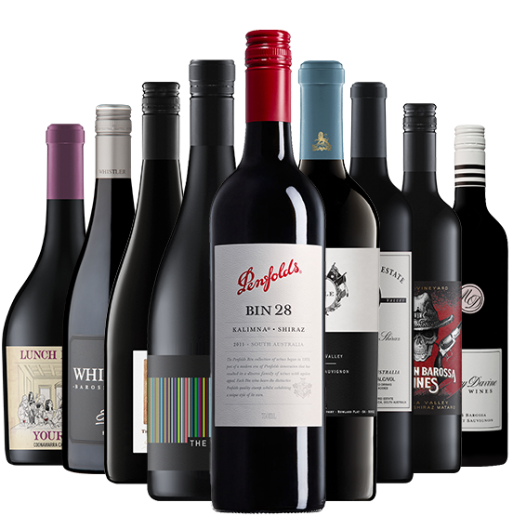
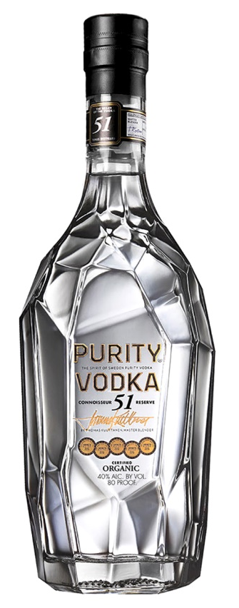
PAMGOLET JUST DRINK LTD DASHBOARD
Wine and Spirits

Slide 2
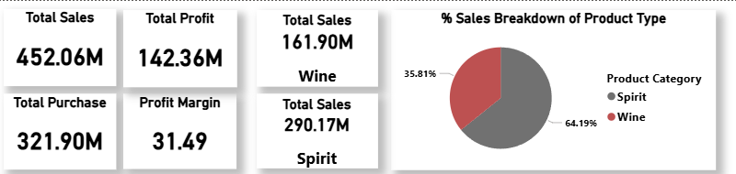
Sales Breakdown
Just Drink ltd had total sales reaching 452.06M, total profit at 142.36M, and a healthy profit margin of 31.49%, indicating efficient cost management and solid profitability.
Spirits dominate the product mix, contributing 290.17M in sales (about 64.19% of total), while wine accounts for 161.90M (around 35.81%), suggesting a higher consumer demand or pricing strength in the spirit category.
The total purchase cost of 321.90M supports a sustainable margin structure, and the breakdown highlights opportunities to optimize wine sales and further enhance profitability through targeted strategies.

Slide 3
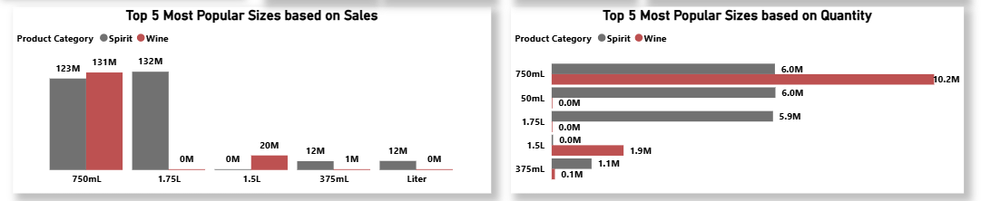
Top 5 Most Popular Sizes by Sales and Quantity
The 750 mL size is the top performer for both wine and spirits in sales and quantity. Wine leads in 1.5 L, while spirits dominate the 1.75 L segment. Smaller sizes show low demand, confirming 750 mL as the preferred consumer choice.

Slide 4
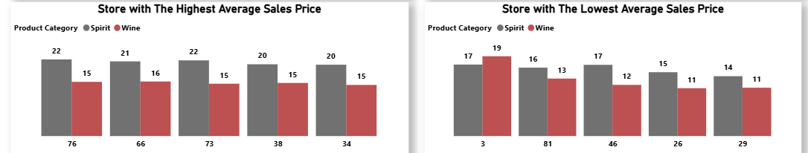
Store with The Highest and Lowest Sales Price
Top Sales: Stores with the highest average sales prices are Store 76 and Store 66, with spirits priced around 22 and wines around 15–16.
Lowest Sales: In contrast, Store 26 and Store 29 offer the lowest prices, with both categories averaging around 10–11. This suggests pricing varies significantly by store, likely due to location, customer base, or strategy.

Slide 5
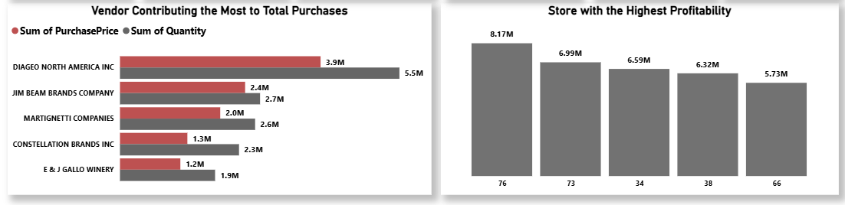
Top Vendors and Store Profitability
Top Vendors: DIAGEO NORTH AMERICA INC leads in both purchase value (3.97M) and frequency (243.33K), making it the most critical supplier.
Store Profitability: The most profitable store generated 8.17M, with others ranging between 5.22M–6.99M, highlighting strong performance variation across locations.

Slide 6
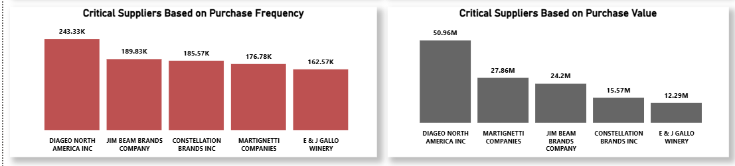
Supplier Impact and Scale Overview
Supplier Impact: BEAM SUNTORY, MARTINSCOTT, CONSTELLATION BRANDS, and MARTIGNETII COMPANIES also show high purchase values and frequencies, indicating strategic importance.
Scale Overview: The business spans 127 vendors, 80 stores, and over 11.24K brands, reflecting a large and diverse operation.

Slide 7
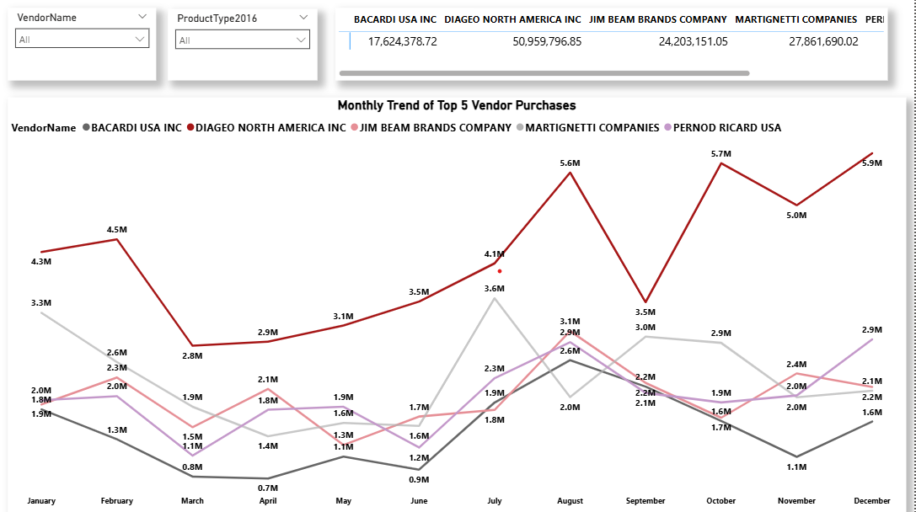
Monthly Trend of Vendors Purchases
DIAGEO NORTH AMERICA INC. shows the strongest and most consistent purchase volume across all months, peaking in mid-year (likely June–August), indicating stable demand and strategic importance year-round.
PERNOD RICARD USA and JIM BEAM BRANDS COMPANY follow with moderate purchase levels, showing seasonal spikes, especially around Q2 and Q4, which may align with promotional periods or holiday demand.
BACARDI USA INC. has the lowest total purchases among the group and displays fluctuating monthly trends, suggesting variable demand or supply cycles.
MARTIGNETTI COMPANIES appears to have intermittent spikes, possibly due to bulk or one-off purchases rather than steady monthly flow.

Slide 8
Month-to-Month Patterns
Q2 and Q4 (April–June, October–December) tend to show higher purchase volumes across most vendors, likely driven by seasonal promotions, holidays, or inventory stocking cycles.
Q1 and Q3 (January–March, July–September) show more variability, with some vendors dipping or surging depending on their product type and market strategy.

Slide 9
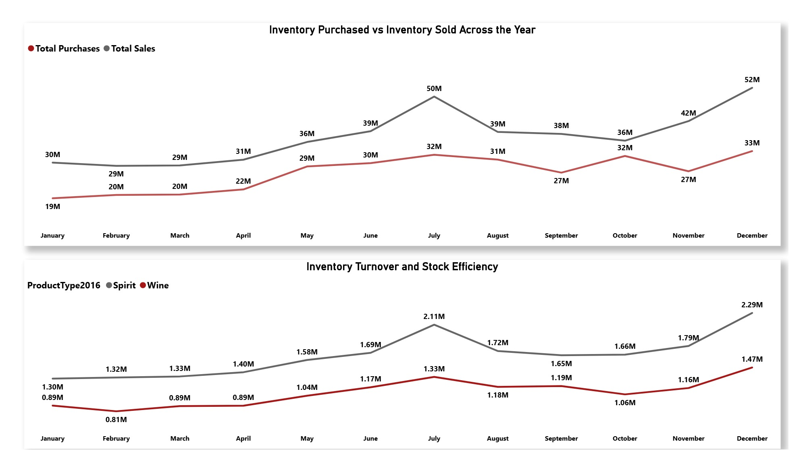
Inventory Purchase Vs Sales
Purchases vs. Sales: Inventory purchases consistently exceeded sales from January to July, but from August to October, sales outpaced purchases, indicating improved stock efficiency or seasonal demand. December saw a sharp spike in purchases (52M) without a matching rise in sales, suggesting year-end restocking.

Slide 10
Inventory Turnover
Inventory Turnover: Wine showed steadier and stronger turnover than spirits in the second half of the year, peaking in August and December. Spirit turnover peaked in July but declined afterward, indicating slower movement.
These trends suggest opportunities to optimize purchasing cycles, especially in Q4, and to leverage wine’s stronger turnover for profitability.

Slide 11
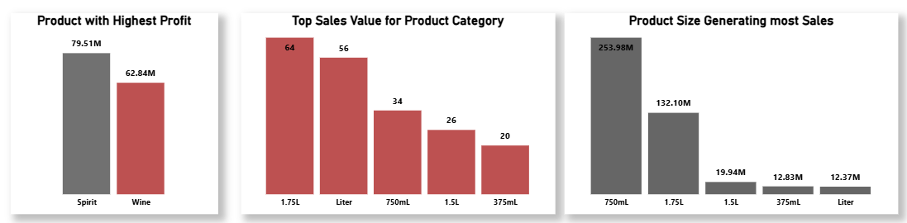
Product With Most Profit/Size with most sales and value
Wine outperforms spirits in profit, generating 79.51M compared to 62.84M, suggesting stronger margins or demand.
The top-selling product size drives over 253.98M in sales, far exceeding others, indicating a clear consumer preference.

Slide 12
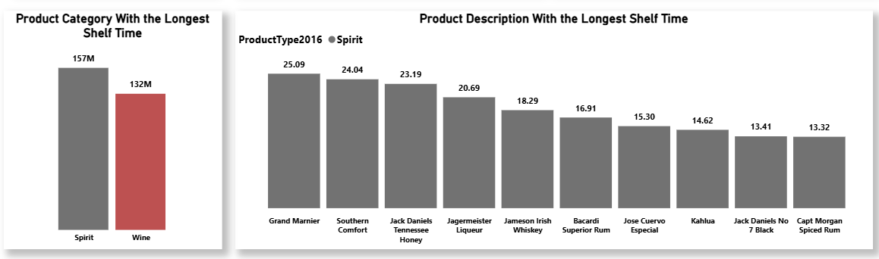
Product With Most Shelf Time
Wine also has the longest shelf time (27.50), slightly higher than spirits (22.67), which may affect inventory planning.
Among product descriptions, Grand Marnier has the longest shelf time (25.90), followed by Southern Comfort and Drambuie, highlighting slower-moving premium items.

Slide 13
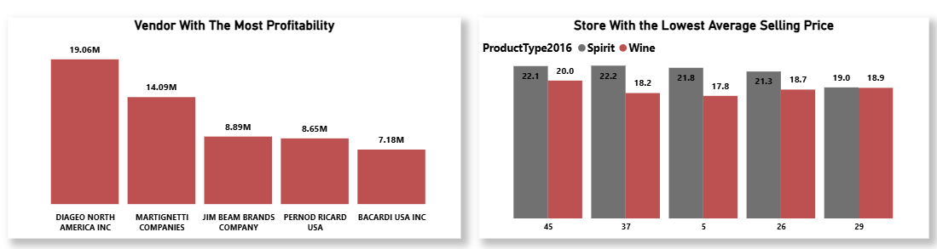
Vendor Profitability and Selling Price Variations
Top Vendor Profitability: DIAGEO NORTH AMERICA leads with 14.69B, followed by MARTINOTTI AMERICAS and JIM BEAM BRANDS, confirming their dominant market impact.
Selling Price Variation: Store 45 has the highest average selling prices (Spirit: 22.1, Wine: 20), while Store 5 has the lowest (Spirit: 21.8, Wine: 17.8), indicating pricing strategies vary widely across locations.

Slide 14
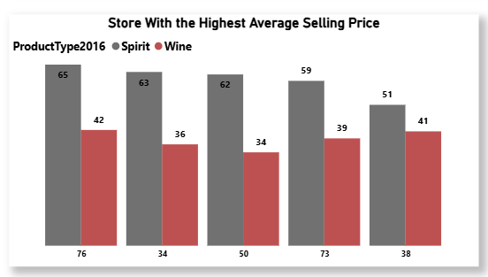
Store With Highest Selling Value
Store 76 has the highest average selling price for spirits (65) and wine (42), making it the top-priced location overall.
Across all six stores, spirits consistently sell at higher prices than wine, with spirit prices ranging from 51 to 65, while wine prices range from 34 to 42.

Slide 15
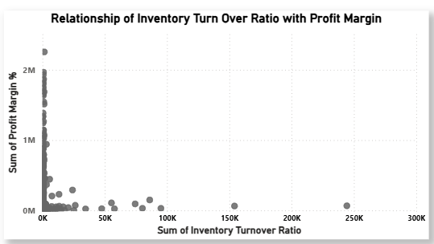
Correlation Between Inventory Turnover and Profit Margin
The correlation between Inventory Turnover Ratio and Profit Margin is virtually zero (1.67 × 10⁻¹⁴), indicating no meaningful relationship between the two.
This means businesses can have high turnover with low margins or low turnover with high margins, and improving one metric does not guarantee improvement in the other. Each should be optimized independently through targeted strategies.

Slide 16
Recommendations
Strengthen Spirit Strategy Spirits contribute over 64% of total sales and show strong pricing power. Focus on premium spirit offerings, vendor partnerships (especially DIAGEO), and high-performing store locations to maximize returns.
Boost Wine Profitability Although wine lags in sales but it has high profits. Enhance wine visibility, optimize shelf space, and target stores with higher wine turnover to unlock margin potential.

Slide 17
Recommendations
Optimize Product Sizing The 750 mL size dominates in both sales and quantity. Prioritize this format in promotions and inventory planning. Consider reducing low-demand smaller sizes to streamline operations.
Refine Store-Level Pricing Pricing varies significantly across stores. Leverage high-price stores (e.g., Store 76, Store 66) for premium positioning, while reassessing pricing strategies in low-price stores (e.g., Store 26, Store 29) to improve margins.

Slide 18
Recommendations
Vendor Relationship Management DIAGEO NORTH AMERICA INC is the most critical supplier by value and frequency. Maintain strong ties and explore volume-based incentives. Monitor seasonal patterns with vendors like PERNOD RICARD and JIM BEAM for promotional alignment.
Inventory & Margin Strategy With no correlation between turnover and profit margin, treat these as independent levers. Use turnover to manage stock efficiency and margin to drive profitability—don’t expect one to influence the other.

Slide 19
Recommendations
Seasonal Purchasing Optimization Q2 and Q4 show peak purchasing activity. Align procurement and marketing efforts with these cycles to capitalize on demand surges and avoid overstocking.
Shelf Time Management Products like Grand Marnier and Southern Comfort have long shelf times. Monitor slow-moving inventory and adjust ordering frequency to reduce holding costs.

Slide 20
OVERALL DASHBOARDS

Slide 21
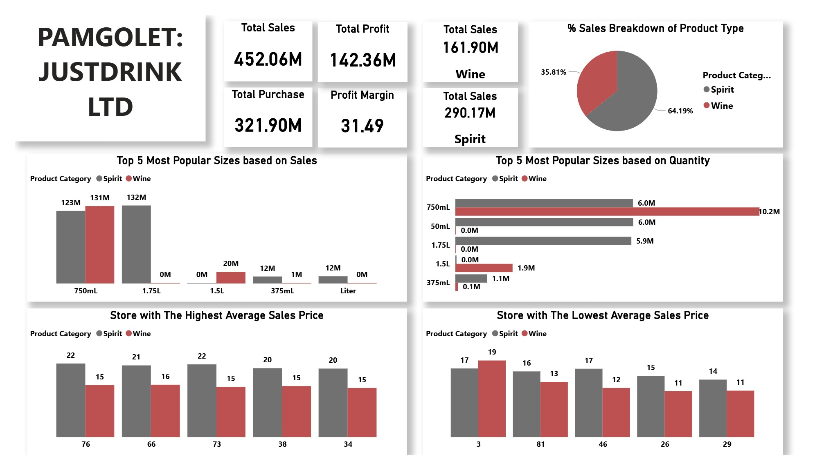

Slide 22
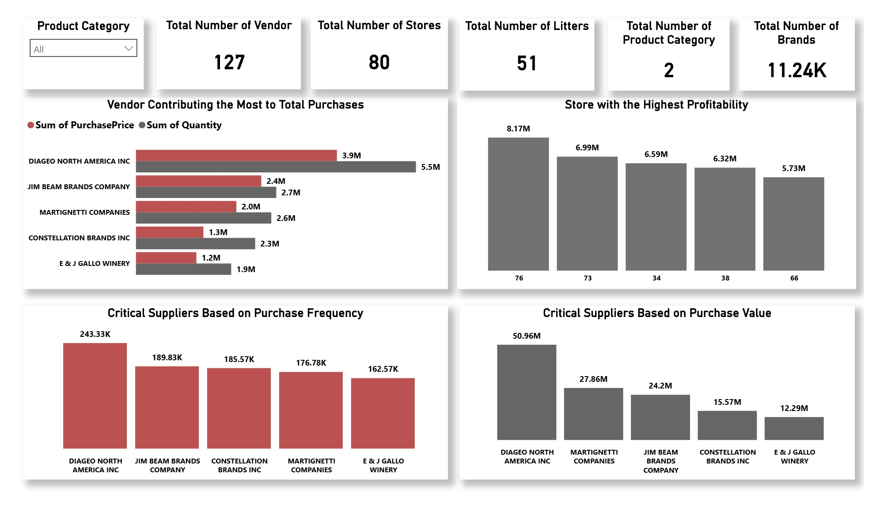

Slide 25
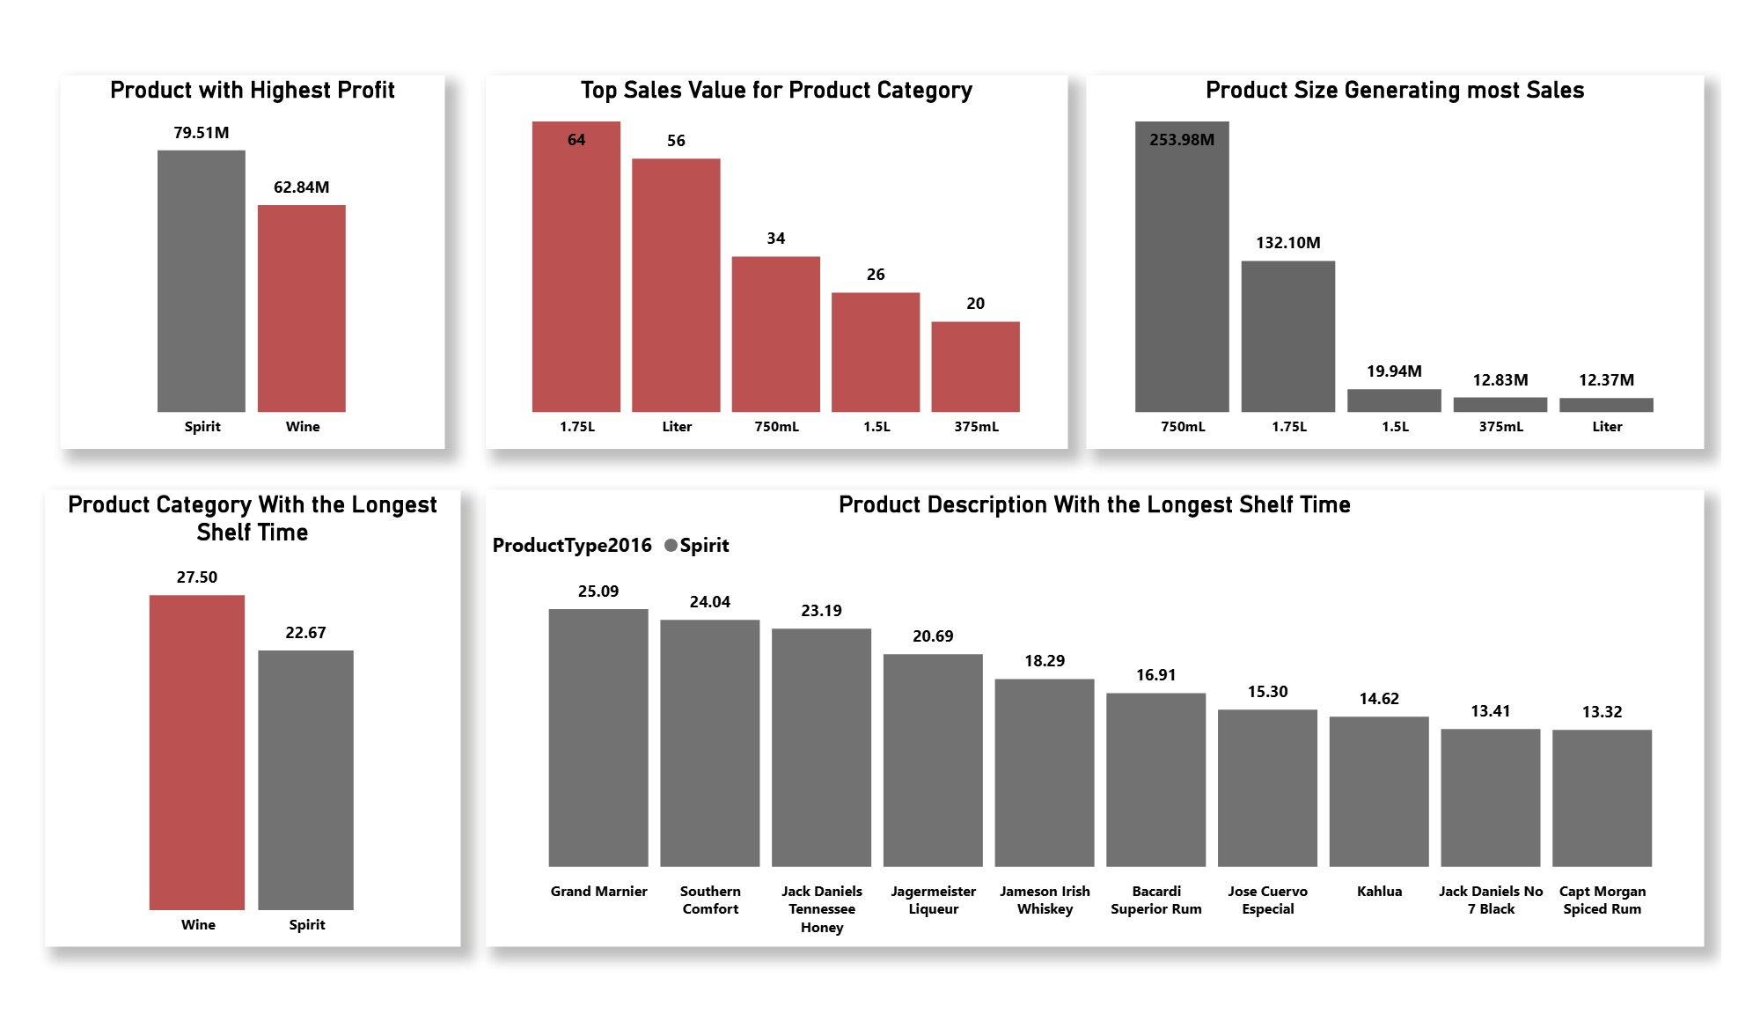

Slide 26
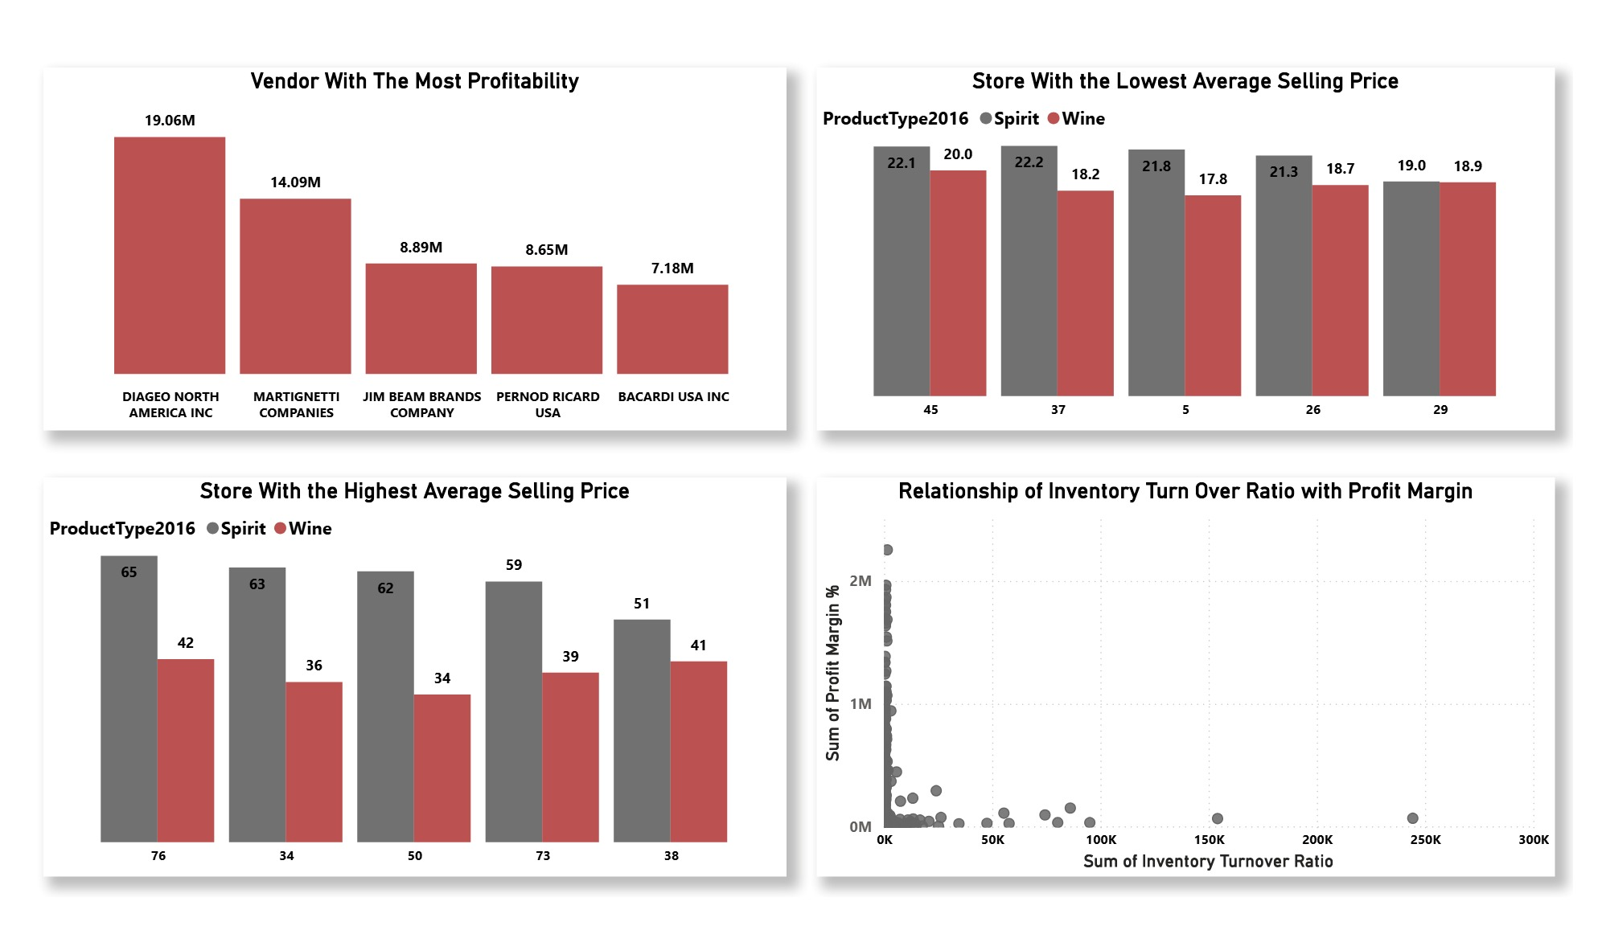

Slide 27
THANK YOU FOR YOUR KEEN ATTENTION
Any Questions?

